Slide 1
Mapping files and common genomic arithmetics
Nicolò Gualandi
Raffaella Picco

Slide 2
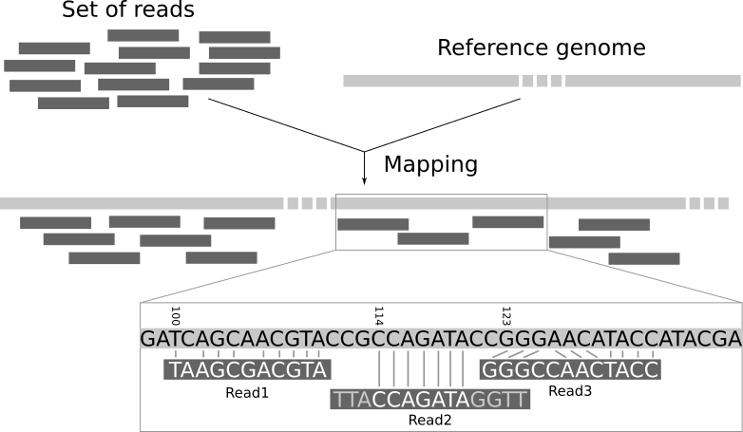
Genomic alignment
Key step in analyzing sequencing data
Enables understanding of genetic variations
Identification of mutations and structural variants
Quantification of gene expression
Aligning short sequence reads to a reference genome
Determine where the reads originated on the reference genome
Involves finding the optimal alignment that minimizes differences (mismatches, gaps) between the read and the reference
Essential for downstream analyses like variant calling, gene expression analysis, and functional annotation

Slide 3
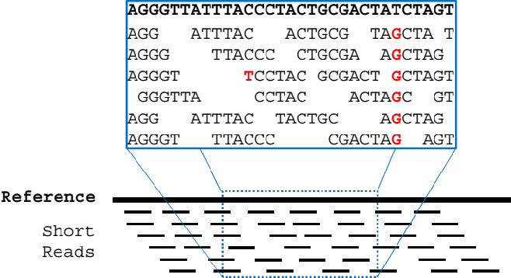
Align reads to the reference genome (DNA)
Find the position that maximize the alignment score (or minimize number of mismatches)
Often multiple solutions are possible (multimapping reads)

Slide 4
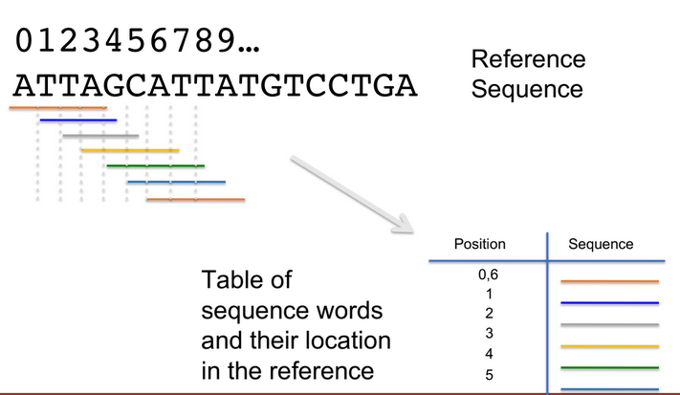
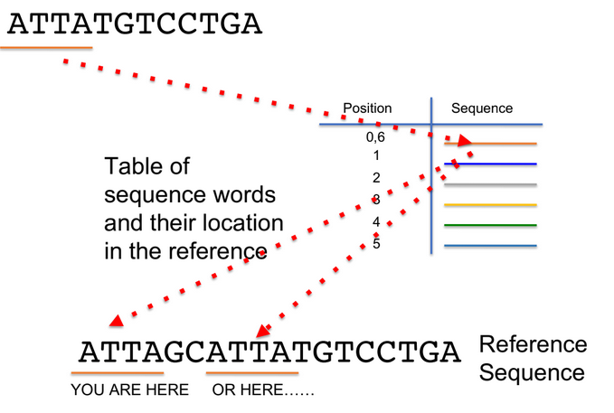
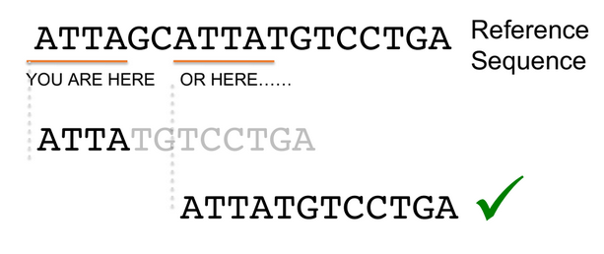
Indexing genome
Indexing allows for more efficient searching of the reference genome during the mapping process. Without an index, the mapping algorithm would need to scan the entire genome each time it searches for a match, making the process slow and computationally intensive.

Slide 5
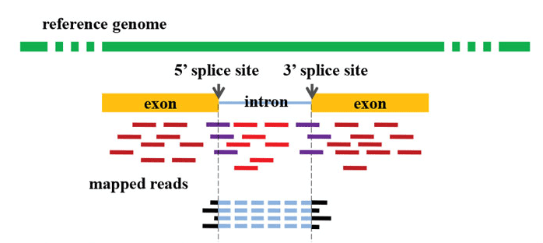
Align reads to the reference genome (RNA)
Align RNA-seq reads face additional difficulties like the presence of introns
Need specific algorithm that consider the presence of introns
Generation of splitted reads

Slide 6
Common reads aligners
BWA-MEM (DNA)
Bowtie2 (DNA)
STAR (RNA)
HiSat2 (RNA)
TopHat (RNA)

Slide 7
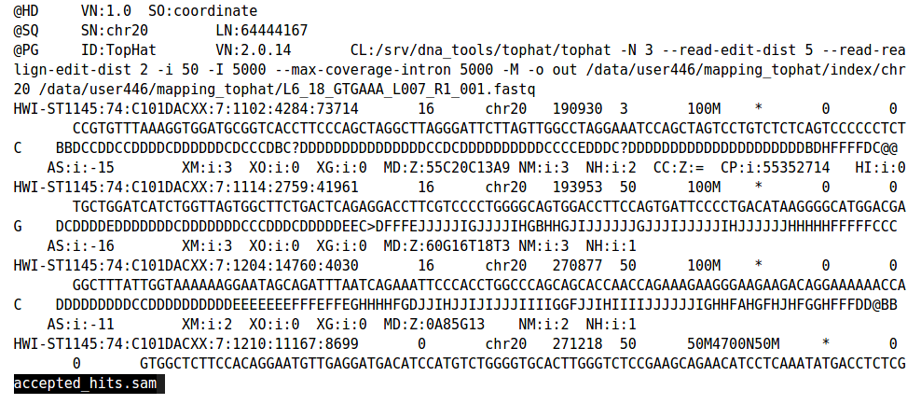
SAM and BAM files
Header : Contains metadata about the alignment process, Information on the reference genome, sequencing platform, and software used
Alignment: Detailed information about each read, including position, sequence, and quality scores

Slide 8
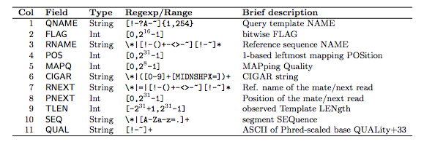
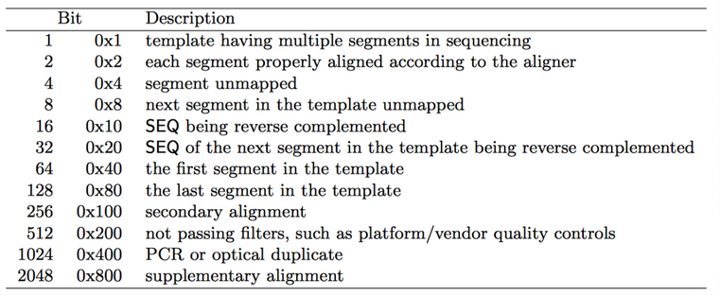
SAM and BAM files
Binary Representation (BAM file):
Efficient storage of SAM data
Allows for faster data access
Advantages:
Reduced file size, especially important for large datasets

Slide 9
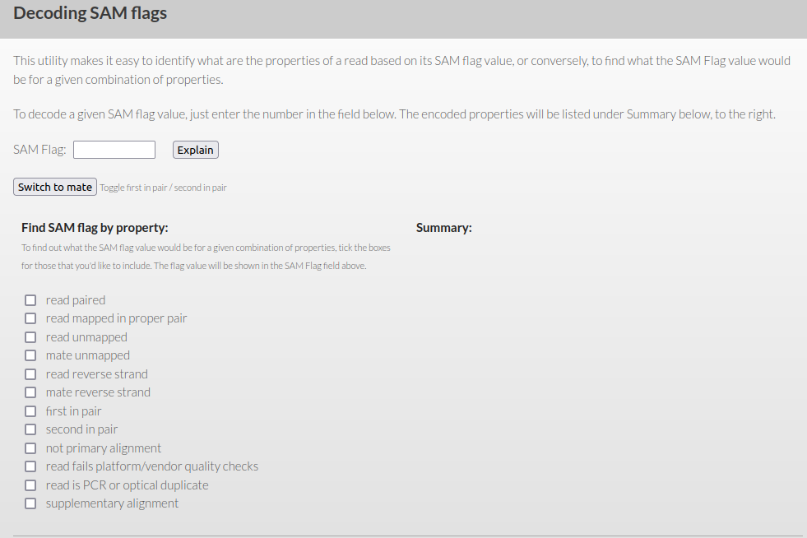
SAM and BAM files
https://broadinstitute.github.io/picard/explain-flags.html

Slide 10
Manipulate SAM/BAM files: Samtools
Samtools is a suite of programs designed for interacting with high-throughput sequencing data. It's particularly useful for manipulating files in the Sequence Alignment/Map (SAM) and Binary Alignment/Map (BAM) formats. Samtools provides a set of utilities that facilitate tasks such as file conversion, sorting, indexing, and various analyses of sequence alignments.
Convert between SAM and BAM formats using samtools view and samtools view -bS
Create index files for BAM files to enable quick retrieval using samtools index
samtools view to display alignments: Filtering options like -q for mapping quality, -F for excluding specific flags
Sort BAM files by genomic coordinates with samtools sort
Assess data quality with flag statistics using samtools flagstat
http://www.htslib.org/

Slide 11
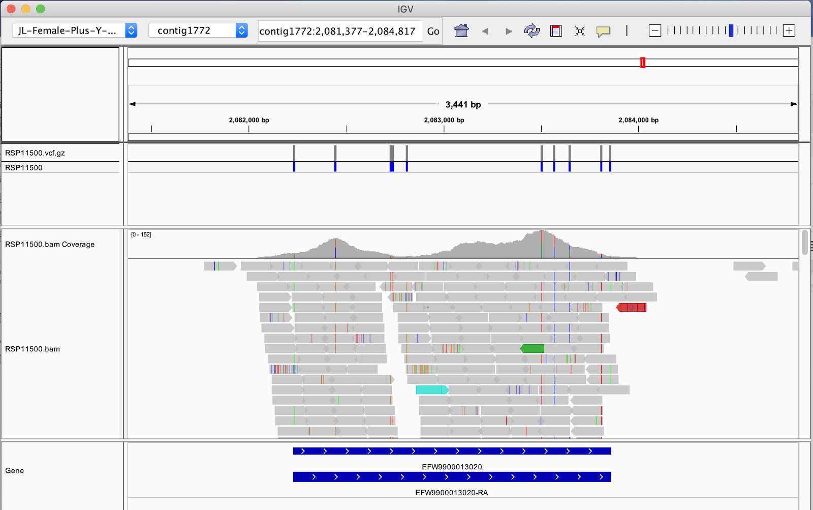
Visualize aligned reads:IGV
IGV is useful for visualizing mapped reads against a reference genome

Slide 12
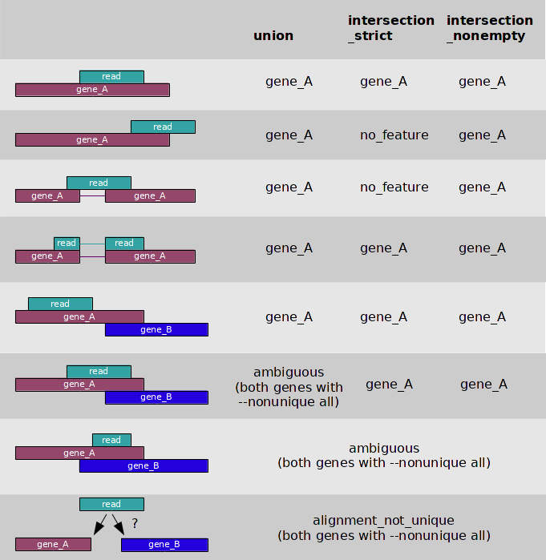
Quantify reads per gene
HTSeq-Count is a tool used for counting the number of reads mapped to genomic features, typically genes.
Converts aligned sequence data (in SAM/BAM format) into count data for downstream analysis.
INPUT: Aligned Sequencing Data: Typically in SAM/BAM format.
INPUT: Annotation File: A file containing genomic features (e.g., gene coordinates in GTF/GFF format).
https://htseq.readthedocs.io/en/release_0.11.1/count.html

Slide 13
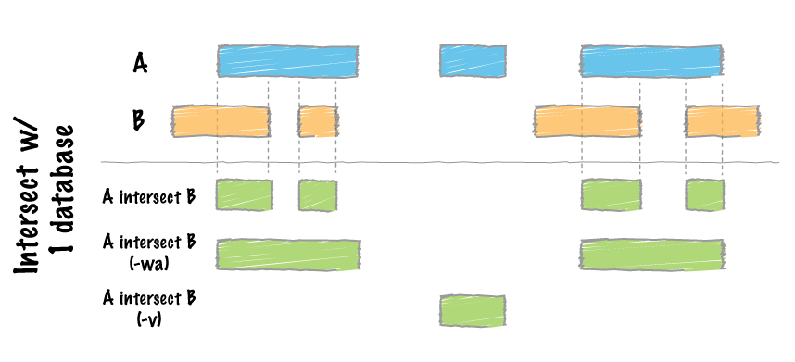
Genomic arithmetic: Bedtools
Genomic intervals represent specific regions on a genome defined by start and end coordinates.
Essential for analyzing genomic data, including DNA sequences, annotations, and functional elements.
Common Formats: BED, GFF, and other standard file formats for representing genomic intervals.
bedtools intersect: Find overlapping intervals between two files.
bedtools merge: Merge overlapping intervals within a file.
bedtools coverage: Calculate the coverage of features in one file by features in another.
bedtools subtract: Subtract intervals in one file from intervals in another.
https://bedtools.readthedocs.io/en/latest/

Slide 14
Genomic arithmetic: Bedtools
Find Which genes are located in the ChIP-seq peaks annotate in the ChIPseq.bed file
Save them to a file for following Enrichment analysis
https://bedtools.readthedocs.io/en/latest/

Slide 15
Enrichment analysis
Enrichment analysis is a bioinformatics method used to identify over-represented biological terms or features within a given set of genes or proteins.
Uncover biological insights by understanding which functional terms are significantly associated with a set of genes of interest.
Common Terms: Gene Ontology (GO) terms, pathways, protein domains.
Gene Ontology (GO) Enrichment: Categorizes genes based on biological processes, cellular components, and molecular functions.
Pathway Enrichment: Identifies over-represented pathways.

Slide 16
Enrichment analysis
Input Data: Provide a list of genes or proteins of interest.Annotation: Annotate genes with functional terms (e.g., GO terms, pathway information).
Statistical Analysis: Assess the enrichment of functional terms using statistical tests (usually an over-representation test: I.e are the Input genes present in my Ontology more than expected by chance, random choice)
Interpretation: Understand the biological meaning of enriched terms.
P-Value: Indicates the probability of observing the enrichment by chance.
False Discovery Rate (FDR): Controls for multiple testing and reduces false positives.
Fold Enrichment: Measures how much more likely a term is in the input list compared to random.

Slide 17
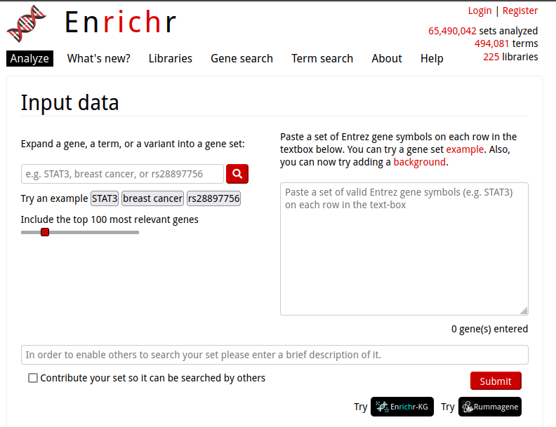
Enrichment analysis
Enrichr: Web-based tool providing access to various enrichment databases
Very basic but fast
Perform an enrichment analysis using genes in ChIPseq.bed peaks file
What is the function of those genes?
What Pathways may be affected by changes in the chromatin status of ChIPseq.bed loci
https://maayanlab.cloud/Enrichr/

